Slide 1
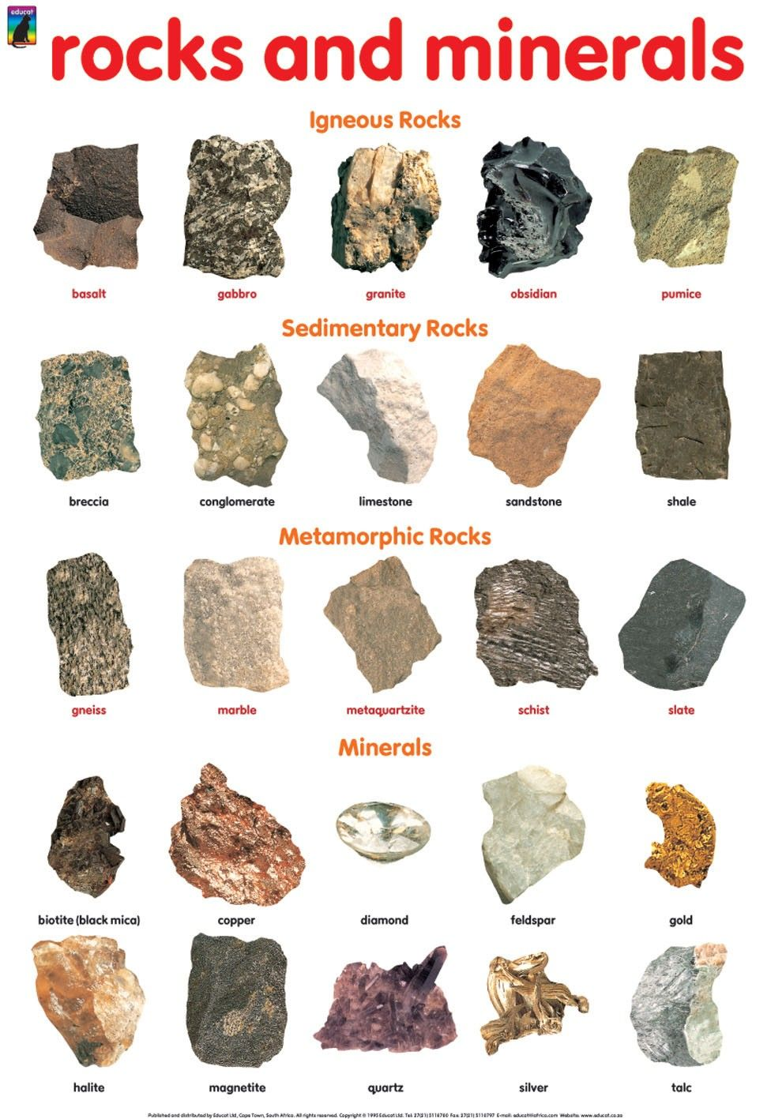
Ln: 3 - ROCKS AND MINERALS
Lesson : 7

Slide 2
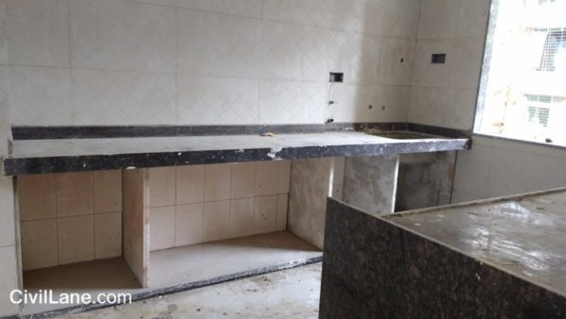
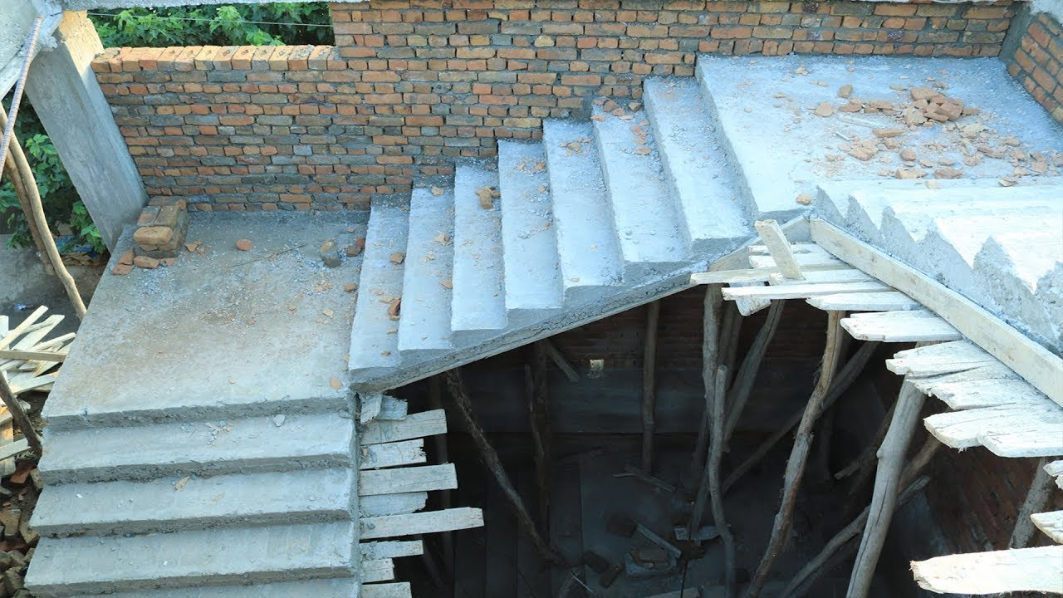
??? TIME Rakshana’s father was a civil engineer. One day her father took Rakshana to the newly constructed house, Rakshana loved the new house but she saw few places like the kitchen top, pooja room, staircases were not completed. When she asked her father about the completion of the pending work, her father said that they are to be pasted with costly stones like the granites and marbles. So they will be done at the end of the work. Whereas the flooring are done using the normal tiles.

Slide 3
Presence of Rocks and Minerals
Rocks:
They are present in the surface of the Earth.
Hills, rivers, above the ground and under the Earth.
They exist in different shapes, colour and size.
Minerals:
The rocks are made up of chemicals substance called the minerals.
One or two minerals combine to form a Rock.

Slide 4
Types of Rocks: Depending upon their formation rocks are of 3 types

Slide 5
Igneous rock – Made from heat and Fire
Magma:
They are the molten rocks present deep inside the earth because of the high temperature.
These molten rocks cools and turns into rocks.
Sometimes these molten rocks _ magma flows out through the weak point or crack in the Earths surface so called Volcanoes.
Lava: The magma that comes out of the Earth.
The harden rock that is formed out of cooled lava is called the igneous rock.
Depending upon the presence of the Air the cooling of the Rocks occurs.(inside slower and outside the Earth faster)

Slide 6
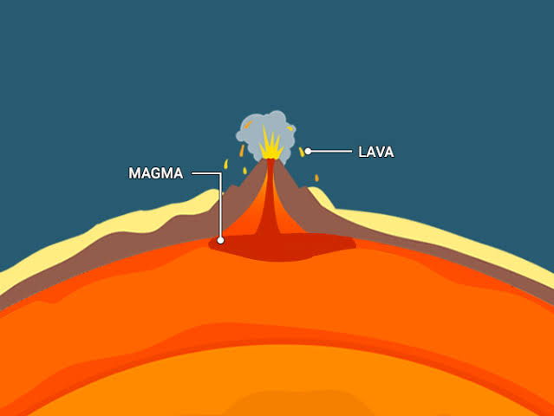
Lava and Magma

Slide 7
Types of Igneous rock
Granite: Made of 3 minerals – mica, quartz and feldsper. They are red, pink, grey, black coloured.
Uses: Kitchen top, paving roads,etc many temples of TN are made of granites.
Basalt: The crushed basalt is used for construction of roads.
Pumice: They are light rocks with many air holes.
Many Pumice rocks float on water.
Uses: Dentist use powered pumice to polish teeth, also used as body scrubber and to polish the floor.

Slide 8
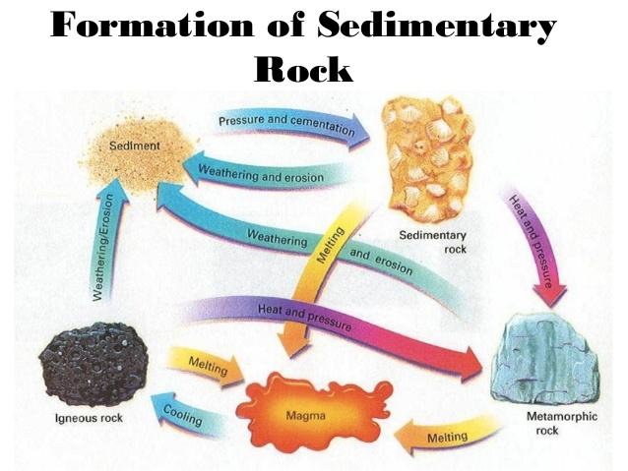
Sedimentary rock
The igneous rock and the metamorphic rocks break down into smaller pieces - affect of heat, wind, rain etc.
The smaller pieces of rocks get settled down and form the sediments and form many layers.
After millions of years these settled sediments form the sedimentary rock.
Some time the dead plants and animals gets trapped inside the rock and leave their impressions so called the Fossils.
Fossils help the scientist to find out the plants and animals that lived on Earth.

Slide 9
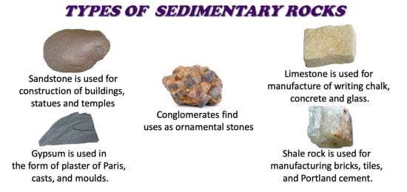
Types of Sedimentary rocks
Sandstone: Layers of sand grains.
Contains quartz and it is red, pink, brown and yellow in colour
Uses: Red fort in Delhi
Conglomerate: Layers of pebbles and gravels.
Thar are grey or orange colour.
Uses: Decorative purpose.
Shale: Layers of clay and mud. When immersed in water they smell mud.
Uses: Brick and tiles.
Limestone: The sea animals that are covered with the shells after they die the shells turn into calcite which later forms limestone.
Chalk is a type of limestone.
Uses: Building stones, cement and glasses.

Slide 10
https://youtu.be/CeuYx-AbZdo
Video on Formation of rocks

Slide 11
Today’s Assignment
1. Name three types of igneous rock.
2. Name the types of Sedimentary rocks.
3. Differentiate between magma and lava.

Slide 12
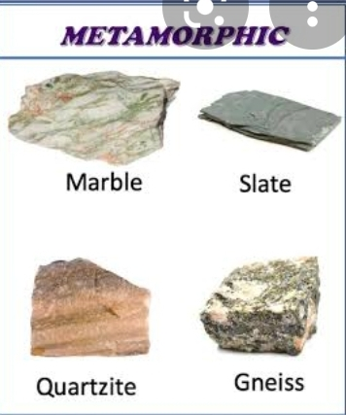
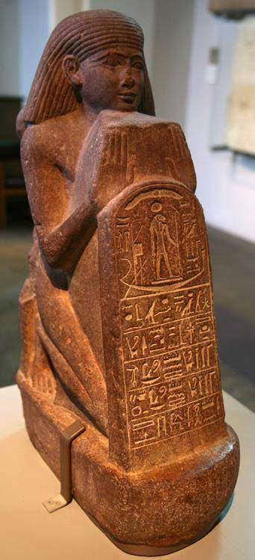
Metamorphic Rock
Metamorphosis: Changing into something new or different.
The igneous and the sedimentary rocks under heat and pressure changes into Metamorphic rock.
They look different from parent rock.
Mostly they are stronger and harder than parent rock.
Some Metamorphic rocks are Marble, Slate, Genius and Quartzite.
Marble: Limestone changes to marble(sedimentary rock to metamorphic rock)
Easily cut and made smooth easily.
Different colors like black, red, white, etc.
Slate: Shale change to slate.
They are black and shiny, can be cut into pieces.
Used to make blackboard, slate etc.
Gniess: Granite changes to gniess(igneous rock to metamorphic rock)
They have light and dark bands.
Used in flooring and paving.
Quartzite: Sandstone changes to Quartzite ( sedimentary rock to metamorphic rock)
They are very hard and used to make status .

Slide 13
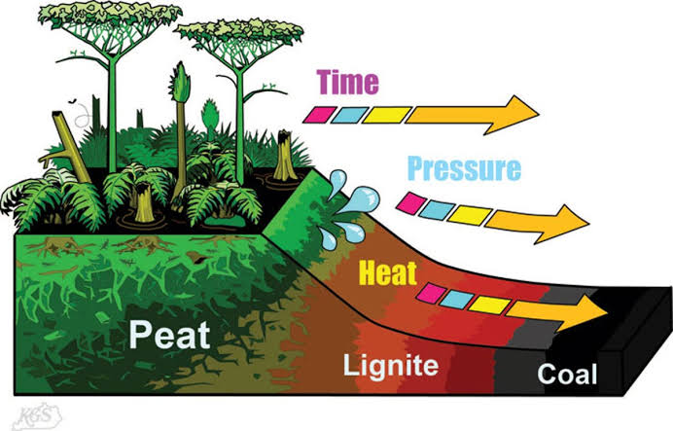
Rocks as Resources
Rocks provide us with important resources such as fuels, metals and gemstones.
Fuel: Coal and petroleum.
Coal: Shiny black Sedimentary rock.
They are found in low lying area and covered with thick swampy forest.

Slide 14
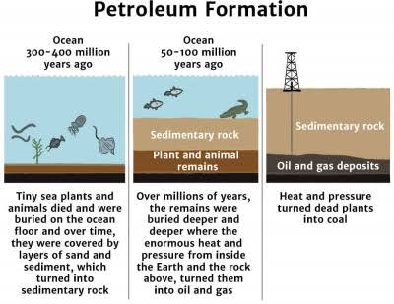
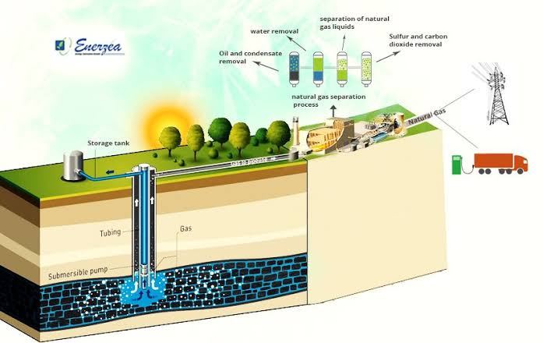
Formation of Petroleum and Natural gas

Slide 15
Video of formation of Petroleum and Natural gas

Slide 16
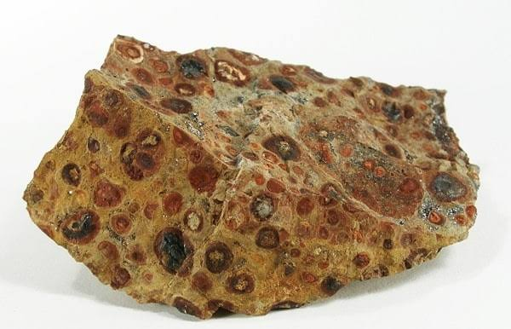
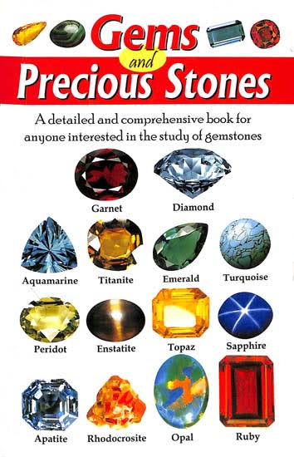
Metals
Ore: Rocks with Minerals which are rich in metals.
Metals are the minerals present in the rocks.
Bauxite: an ore of Aluminum
Uses: utensils, aircraft, etc.
Metals like gold and silver are used to make jewelry.
Gemstones: Gemstores are precious rocks that are cut and polished and used.
Thay are diamond, ruby, emerald etc.

Slide 17
Today’s Assignment
How are metamorphic rocks formed?
What are the products obtained from petroleum.?
What are metals? Give example.
Name few gem stones.

